Slide 1
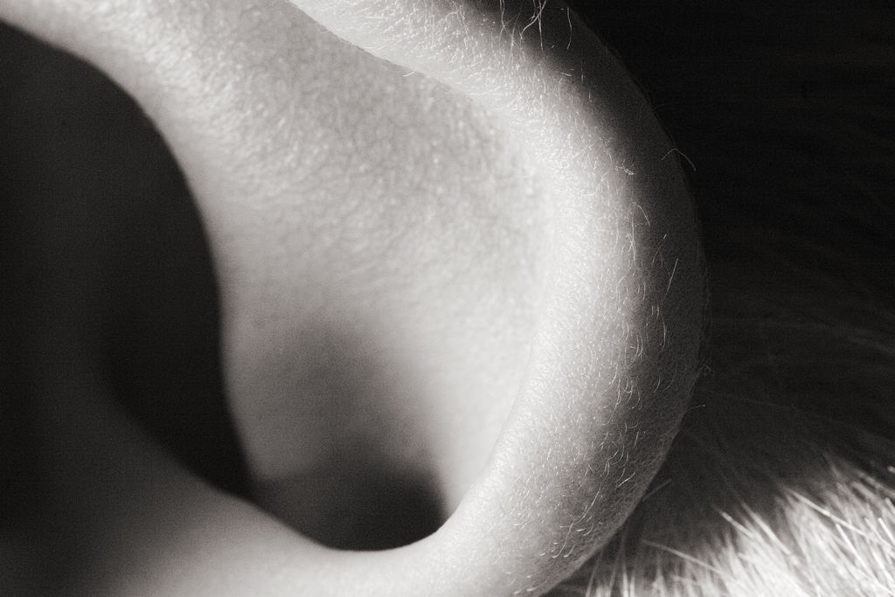

Hearing
[Course Section Number]
[Instructor Name]
Notes:
Hearing can be taught in one class period.
Instructor’s note: Begin by sharing the following quote and asking students why they think Keller believed this to be true: A saying often attributed to Helen Keller, “is that blindness separates us from things, but deafness separates us from people.”
Further discussion: Spend a few minutes talking about the importance of all the senses; then guide the discussion to hearing and its importance.

Slide 2
Overview
Perceptual Attributes of Sounds
Auditory System
Audibility, Frequency, & Masking
Spatial Hearing
Auditory Scene Analysis
Conclusion
Notes:
The purpose of this slide is to provide students with an overview of the material that will be covered during the lecture.
Technical Note: These slides may contain simple click animation so that you can focus students’ attention on a particular question, a selection of text, or an image and not have them be distracted by reading ahead. You can either preview the sequence of animation by going through the slides in slideshow view, visiting the animations tab, or reviewing the slide notes. In the notes you will see a cue - (Click) – that corresponds to each animation.
You will also find hyperlinks to outside videos at various places in the slides. These hyperlinks are embedded in text and indicated by color and in the notes section.

Slide 3
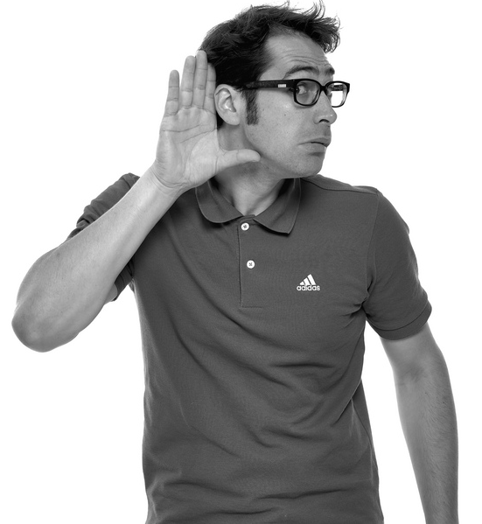
Perceptual Attributes of Sound
Loudness
Pressure
Pitch
⬆ Frequency = ⬆ Pitch
Frequency = ⬇ Pitch
Timbre
Distinction
Notes:
This slide describes the perceptual attributes of sound.
Discussion question: If loudness can be a physical sensation, how would you describe that physical sensation? In other words, how does sound feel?
(Click) Loudness: pressure
Explanation: The most direct physical correlate of loudness is sound intensity (or sound pressure) measured close to the eardrum.
(Click) Pitch: frequency = pitch
Explanation: Pitch is perceived through the repetition rate of a waveform. The faster a waveform repeats over time, the higher is its perceived pitch. Pitch plays an important role in music and certain languages (e.g., Chinese dialects – Mandarin, Cantonese, etc.).
Discussion question: How does our ability to perceive pitch affect our ability to communicate through spoken language?
Answer: Students will have varied responses, but ultimately, they should be able to talk about the importance of tone of voice and how it relates to our ability to understand the underlying meaning behind the words we speak.
(Click): Timbre: distinction
Explanation: Timbre refers to the quality of sound and is often described using words such as bright, dull, harsh, and hollow. Technically, timbre includes anything that allows us to distinguish two sounds that have the same loudness, pitch, and duration. For instance, a violin and a piano playing the same note sound very different, based on their sound quality or timbre.

Slide 4
Overview
Perceptual Attributes of Sounds
Auditory System
Audibility, Frequency, & Masking
Spatial Hearing
Auditory Scene Analysis
Conclusion
Notes:
The purpose of this slide is to provide students with an overview of the material that will be covered during the lecture.

Slide 5
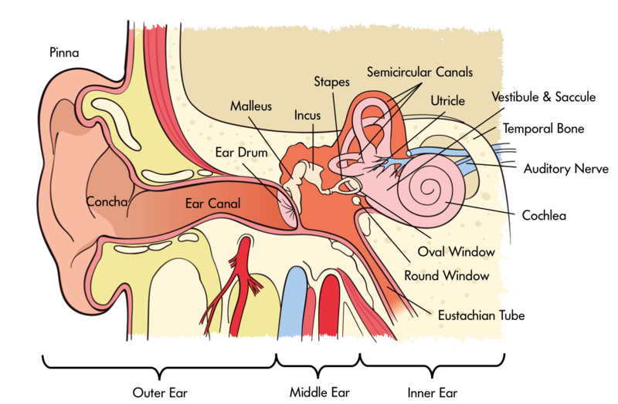
Auditory System
Outer Ear
Pinna
Canal
Tympanic Membrane
Middle Ear
Hammer
Mallet
Stirrup
Inner Ear
Cochlea
Middle Ear
Notes:
This slide introduces the anatomy of the auditory system.
Instructor’s note: The next two slides are fairly dense. Your primary goals for this class will determine how much time you spend on these slides. If you want students to fully understand the complex processes and learn all of the biology, plan to spend quite a bit of time here. If your primary goal is for students to gain a basic understanding of the process, know that this section is a bit confusing and let students know it’s ok if they don’t remember every part of the ear, and you can spend less time here.
Show video: The video hyperlinked to “Outer Ear” on this slide is 7 minutes long and depicts the auditory process. The video is quite detailed, so it may be helpful to pause it and point out the important points that overlap with the textbook.
Explanation:
The outer ear consists of the pinna (the visible part of the ear, with all its unique folds and bumps), the ear canal (or auditory meatus), and the tympanic membrane (ear drum), which separates the outer ear from the middle ear.
The pinna filters and helps us localize sounds and resolve potential front-back and up-down confusion. The pinna is especially useful when locating sound that is directly behind an individual. The folds and bumps of the pinna produce distinct peaks and dips in the frequency response that depend on the location of the sound source.
The canal is the space that leads to the tympanic membrane or ear drum.
The middle ear consists of an air-filled cavity, which contains the three middle-ear bones: incus, malleus, and stapes, (also called hammer, mallet, and stirrup because of their respective shapes). Their primary function is to transmit the vibrations from the tympanic membrane to the oval window of the cochlea and, via a form of lever action, to better match the impedance of the air surrounding the tympanic membrane with that of the fluid within the cochlea.
The inner ear includes the cochlea, encased in the temporal bone of the skull, in which the mechanical vibrations of sound are transduced into neural signals that are processed by the brain.
The cochlea is a spiral-shaped structure filled with fluid. Along the length of the spiral runs the basilar membrane, which vibrates in response to the pressure differences produced by vibrations of the oval window.
Sitting on the basilar membrane is the organ of Corti, which runs the entire length of the basilar membrane from the base (by the oval window) to the apex (the “tip” of the spiral). The organ of Corti includes three rows of outer hair cells and one row of inner hair cells, which sense the vibrations by way of tiny hairs. The outer hair cells seem to function to mechanically amplify the sound-induced vibrations, whereas the inner hair cells form synapses with the auditory nerve and transduce those vibrations into action potentials, or neural spikes, which are transmitted along the auditory nerve to higher centers of the auditory pathways.

Slide 6
Auditory System
Cochlea
Frequency Spectrum
of Hearing Response
Nerve Impulse
Sound Waves
Ear Drum
Auditory
Receptor Cells
Superior Olivary Nucleus
Medial Geniculate Body
Cochlea
Cochlear Nucleus
Inferior Colliculus
Auditory Cortex
Notes:
This slide describes the process of perceiving sound.
Explanation: One of the most important tasks in the auditory process is frequency analysis. This is established in the cochlea which breaks down the many frequencies that make up a complex sound into their constituent frequencies, with low frequencies creating maximal basilar-membrane vibrations near the apex, or top, of the cochlea and high frequencies creating maximal basilar-membrane vibrations nearer the base of the cochlea.
Auditory signals go through many stages of processing before they reach the primary auditory cortex, located in the temporal lobe. With the possible exception of spatial localization and neurons tuned to certain locations in space, there is very little consensus on the how, what, and where of auditory feature extraction and representation.

Slide 7
Overview
Perceptual Attributes of Sounds
Auditory System
Audibility, Frequency, & Masking
Spatial Hearing
Auditory Scene Analysis
Conclusion
Notes:
The purpose of this slide is to provide students with an overview of the material that will be covered during the lecture.

Slide 8
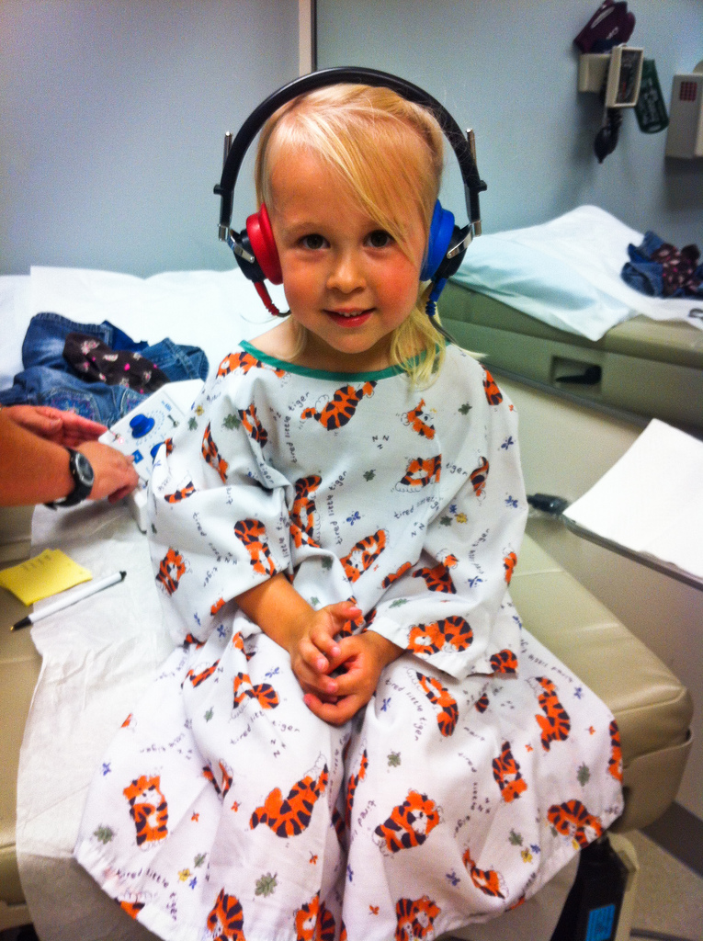
Audibility, Frequency & Masking
Audibility
20Hz – 20kHz
Masking
Swamps
Suppression
Low Frequency > High Frequency
Notes:
This slide describes the process of audibility, frequency, and masking.
Explanation: The human cochlea provides us with hearing over a very wide range of frequencies. Young people with normal hearing are able to perceive sounds with frequencies ranging from about 20 Hz all the way up to 20 kHz. The range of intensities we can perceive is also impressive: the quietest sounds we can hear in the medium-frequency range (between about 1 and 4 kHz) have a sound intensity that is about a factor of 1,000,000,000,000 less intense than the loudest sound we can listen to without incurring rapid and permanent hearing loss.
Discussion: Ask students how many of them sleep with sound machines.
Explanation: Sound machines are an excellent example of masking. Masking is the process by which the presence of one sound makes another sound more difficult to hear. A more intense sound will mask a less intense sound, provided the following:
The frequency content of the sounds overlap, such that the activity in the cochlea produced by a masking sound “swamps” that produced by the target sound.
Another type of masking, known as “suppression,” occurs when the response to the masker reduces the neural (and in some cases, the mechanical) response to the target sound. Low-frequency sounds are more likely to mask high frequencies than vice versa, particularly at high sound intensities. This asymmetric aspect of masking is known as the “upward spread of masking.”

Slide 9
Overview
Perceptual Attributes of Sounds
Auditory System
Audibility, Frequency, & Masking
Spatial Hearing
Auditory Scene Analysis
Conclusion
Notes:
The purpose of this slide is to provide students with an overview of the material that will be covered during the lecture.

Slide 10
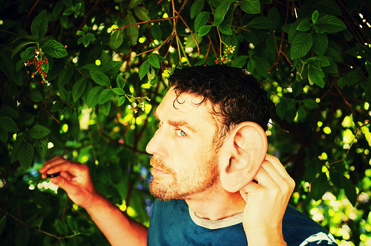
Spatial Hearing
Orienting to Sound Sources
Interaural Time Differences
Low Frequencies > High Frequencies
Interaural Level Differences
Low Frequencies < High Frequencies
Notes:
This slide describes the process of locating sounds in space.
Instructor’s note: Consider beginning this slide with one or both of the following demonstrations:
Localization 1: Use a 30 inch piece of hose with the midpoint marked. Have one volunteer put the ends of the hose to each ear and close eyes. Then tap along the hose and have the student determine if the tap is to the left or right.
Localization 2: Have two volunteers stand one behind the other. The student in the back gets a clicker. The listener has to determine if clicks come from the left, right, or overhead.
Discussion question: Ask students why sound location is an important trait. How does it aid in human survival?
Explanation: Sound location is most useful in alerting us and allowing us to orient towards sources, with our visual sense generally providing the finer-grained analysis. The two mechanisms that allow individuals to orient to sound include analysis of interaural time differences and interaural level differences.
(Click) Interaural time differences: Low frequencies are more likely to be perceived than high frequencies.
Interaural time differences relies on the fact that a sound source on the left will generate sound that will reach the left ear slightly before it reaches the right ear. The largest ITD we encounter in the real world (when sounds are directly to the left or right of us) are only a little over half a millisecond. In general, we are most sensitive to interaural time differences, which are most helpful at low frequencies (below about 1.5 kHz).
(Click) Interaural level differences: High frequencies are more likely to be perceived than low frequencies.
The Interaural level difference detects different frequencies between the two ears. At higher frequencies (higher than about 1 kHz), the head casts an acoustic “shadow,” so that when a sound is presented from the left, the sound level at the left ear is somewhat higher than the sound level at the right ear. In general, we are most sensitive to interaural level differences at high frequencies.

Slide 11
Overview
Perceptual Attributes of Sounds
Auditory System
Audibility, Frequency, and Masking
Spatial Hearing
Auditory Scene Analysis
Conclusion
Notes:
The purpose of this slide is to provide students with an overview of the material that will be covered during the lecture.

Slide 12


Auditory Scene Analysis
Multiple Sounds in an Environment
Heuristic Principles
Computational Auditory Scene Analysis
Notes:
This slide helps to illustrate auditory scene analysis, which is the complex and incredible way the auditory system helps us make sense of our acoustic environment.
Discussion question: How do you manage to have conversations in noisy environments? How do you think your auditory system helps you with this?
Explanation: Somehow the auditory system is able to break down, or decompose, these complex waveforms and allow us to make sense of our acoustic environment by forming separate auditory “objects” or “streams,” which we can follow as the sounds unfold over time.
Heuristic principles have been formulated to describe how sound elements are grouped to form a single object or segregated to form multiple objects. According to these rules of thumb, sounds that are in close proximity, in time or frequency, tend to be grouped together. Additionally, sounds that begin and end at the same time tend to form a single auditory object. Several studies have looked into the relative importance of different cues by “trading off” one cue against another.
Computational auditory scene analysis (CASA) has emerged as more principled, neutrally based approaches to understanding the parsing and perception of complex auditory scenes. The use of CASA will likely lead to more advanced hearing aids and cochlear ear implants.

Slide 13
Overview
Perceptual Attributes of Sounds
Auditory System
Audibility, Frequency, & Masking
Spatial Hearing
Auditory Scene Analysis
Conclusion
Notes:
The purpose of this slide is to provide students with an overview of the material that will be covered during the lecture.

Slide 14
Conclusion
Highly Complex
Multiple Components
Multiple Cues
Not Thoroughly Understood
Notes:
This slide is meant to give students a “take-home” message from today’s lecture.
Essentially, the auditory process is a highly complex process with multiple components that utilizes multiple cues. Despite significant amounts of research, the auditory system is still not well understood because of the complexity of the components and innate human abilities such as “cue switching” that allow humans to alternate cues in detecting sounds and the location of sounds.

Slide 15
Photo Attribution
Slide 1 | Photo Credit: schani https://www.flickr.com/photos/28311604@N00/33622729/ https://creativecommons.org/licenses/by-sa/2.0
Slide3 | Photo Credit: Sebastiaan ter Burg https://www.flickr.com/photos/31013861@N00/8127253723/ https://creativecommons.org/licenses/by/2.0/
Slide 6 | Photo Credit: Original diagram by Tim Gollisch, Andreas M. V. Herz, and Public Library of Science http://upload.wikimedia.org/wikipedia/commons/8/80/Processing-of-sound.svg http://creativecommons.org/licenses/by/2.5/deed.en
Slide 8 | Photo Credit: meggle https://www.flickr.com/photos/63215589@N00/8064082940/ https://creativecommons.org/licenses/by-nc-nd/2.0/
Slide 10 | Photo Credit: CarbonNYC https://www.flickr.com/photos/15923063@N00/7312596038/ https://creativecommons.org/licenses/by/2.0/
Slide 12 | Photo Credit: thetaxhaven https://www.flickr.com/photos/83532250@N06/7651028854/ https://creativecommons.org/licenses/by/2.0/
Slide 12 | Photo Credit: Rowan University Publications https://www.flickr.com/photos/47092418@N08/14227913488/ https://creativecommons.org/licenses/by-nc-nd/2.0/

